Slide 1
Logic Simplification
Notes:
‹#›

Slide 2

Simplification Using Boolean Algebra
A simplified Boolean expression uses the fewest gates possible to implement a given expression.
A
AB+A(B+C)+B(B+C)
B
C
Notes:
‹#›

Slide 3

Simplification Using Boolean Algebra
AB+A(B+C)+B(B+C)
(distributive law)
AB+AB+AC+BB+BC
(rule 7; BB=B)
AB+AB+AC+B+BC
(rule 5; AB+AB=AB)
AB+AC+B+BC
(rule 10; B+BC=B)
AB+AC+B
(rule 10; AB+B=B)
B+AC
A
B
C
AB+A(B+C)+B(B+C)
B
B+AC
A
C
Notes:
‹#›

Slide 4
Standard Forms of Boolean Expressions
All Boolean expressions, regardless of their form, can be converted into either of two standard forms:
The sum-of-products (SOP) form
The product-of-sums (POS) form
Standardization makes the evaluation, simplification, and implementation of Boolean expressions much more systematic and easier.
Notes:
‹#›

Slide 5
Sum-of-Products (SOP)
Notes:
‹#›

Slide 6
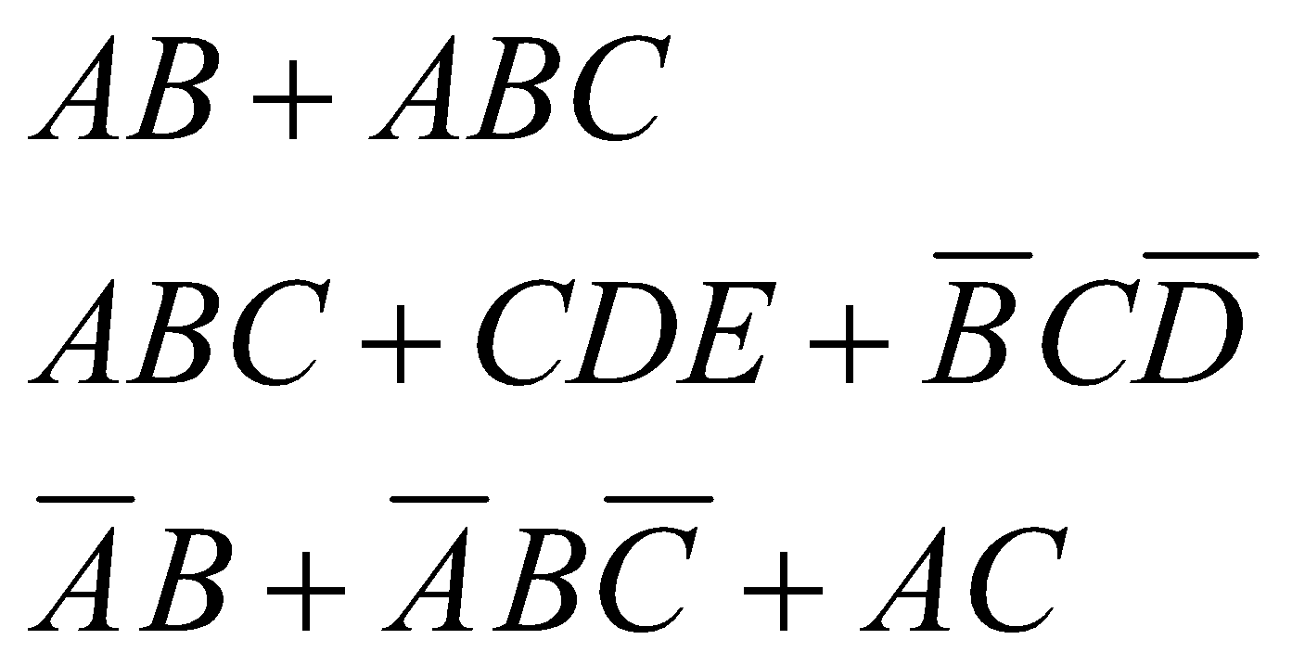
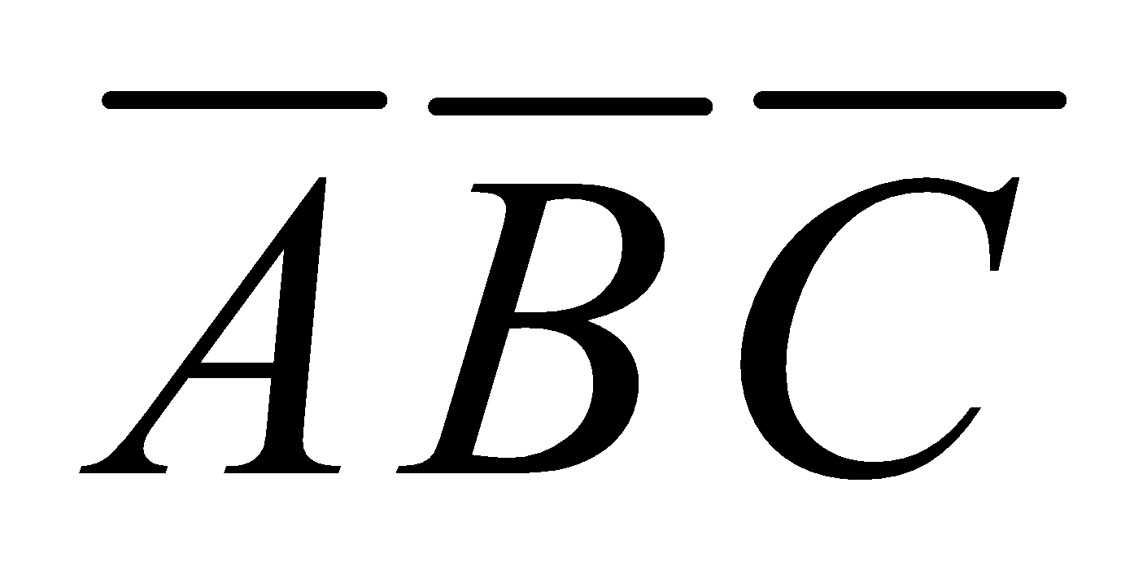
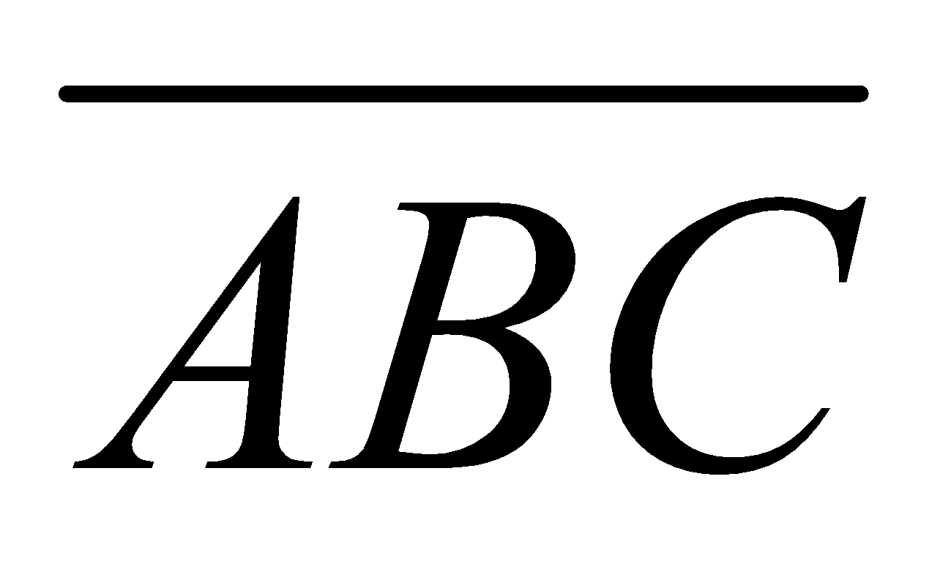
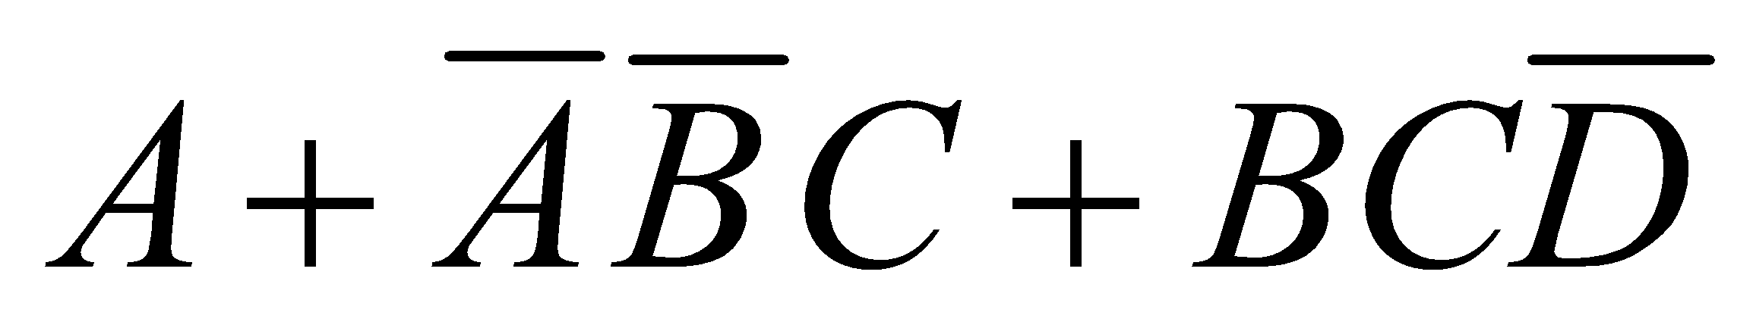
The Sum-of-Products (SOP) Form
An SOP expression 🡪 when two or more product terms are summed by Boolean addition.
Examples:
Also:
In an SOP form, a single overbar cannot extend over more than one variable; however, more than one variable in a term can have an overbar:
example: is OK!
But not:
Notes:
‹#›

Slide 7


Implementation of an SOP
X=AB+BCD+AC
AND/OR implementation
NAND/NAND implementation
A
A
B
B
B
B
C
X
C
X
D
D
A
A
C
C
Notes:
‹#›

Slide 8
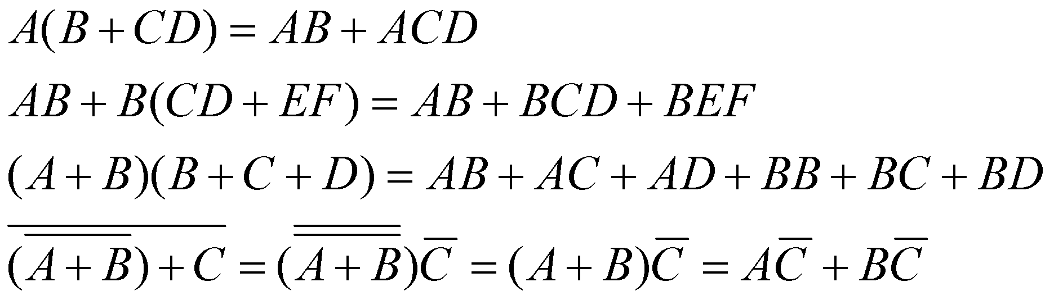
General Expression 🡪 SOP
Any logic expression can be changed into SOP form by applying Boolean algebra techniques.
ex:
Notes:
‹#›

Slide 9
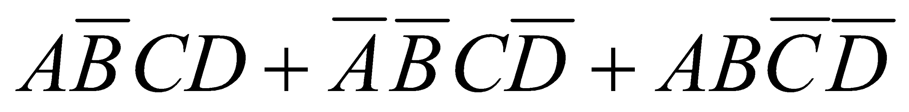
The Standard SOP Form
A standard SOP expression is one in which all the variables in the domain appear in each product term in the expression.
Example:
Standard SOP expressions are important in:
Constructing truth tables
The Karnaugh map simplification method
Notes:
‹#›

Slide 10
Converting Product Terms to Standard SOP
Step 1: Multiply each nonstandard product term by a term made up of the sum of a missing variable and its complement. This results in two product terms.
As you know, you can multiply anything by 1 without changing its value.
Step 2: Repeat step 1 until all resulting product term contains all variables in the domain in either complemented or uncomplemented form. In converting a product term to standard form, the number of product terms is doubled for each missing variable.
Notes:
‹#›

Slide 11
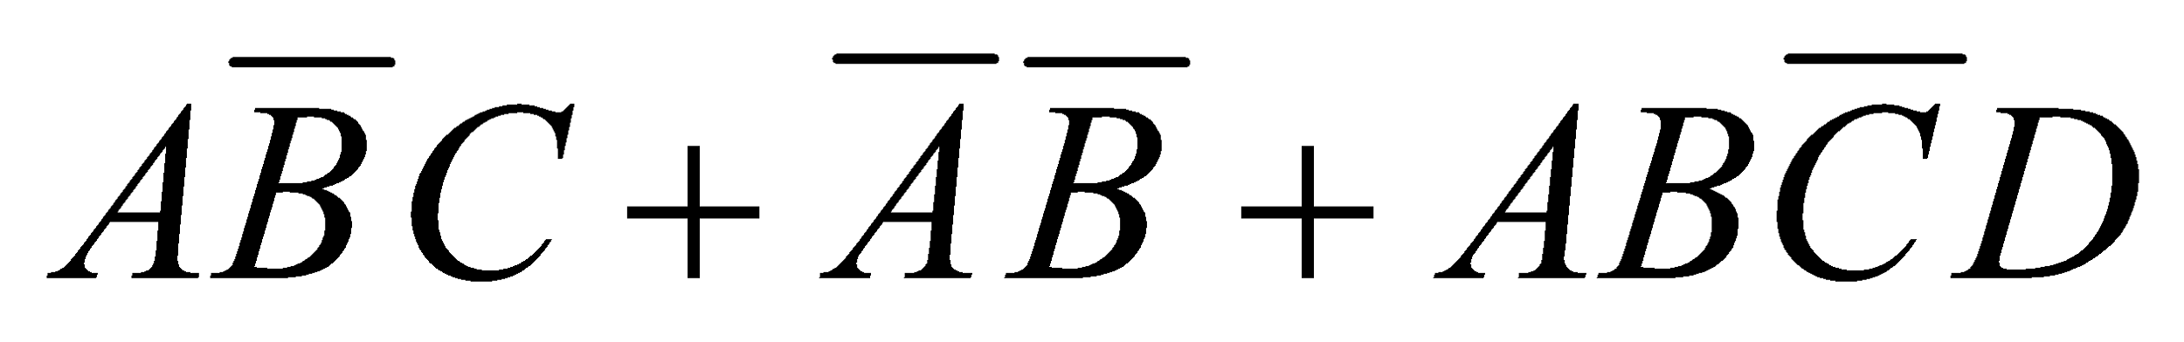
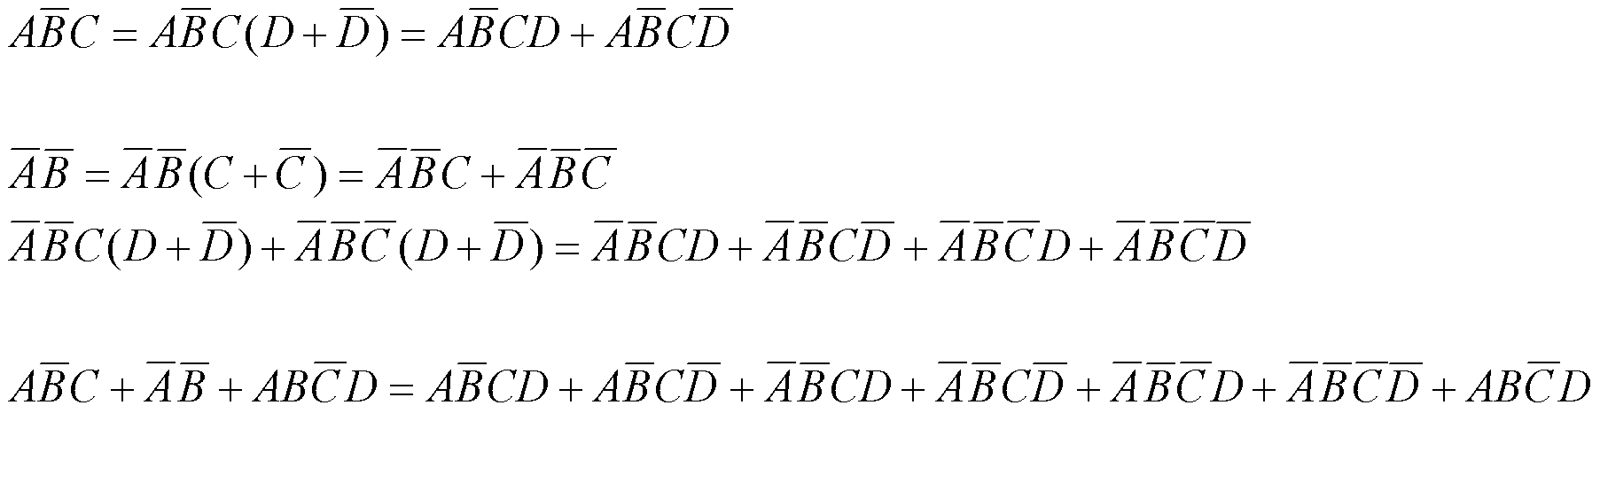
Converting Product Terms to Standard SOP (example)
Convert the following Boolean expression into standard SOP form:
8
Notes:
‹#›

Slide 12
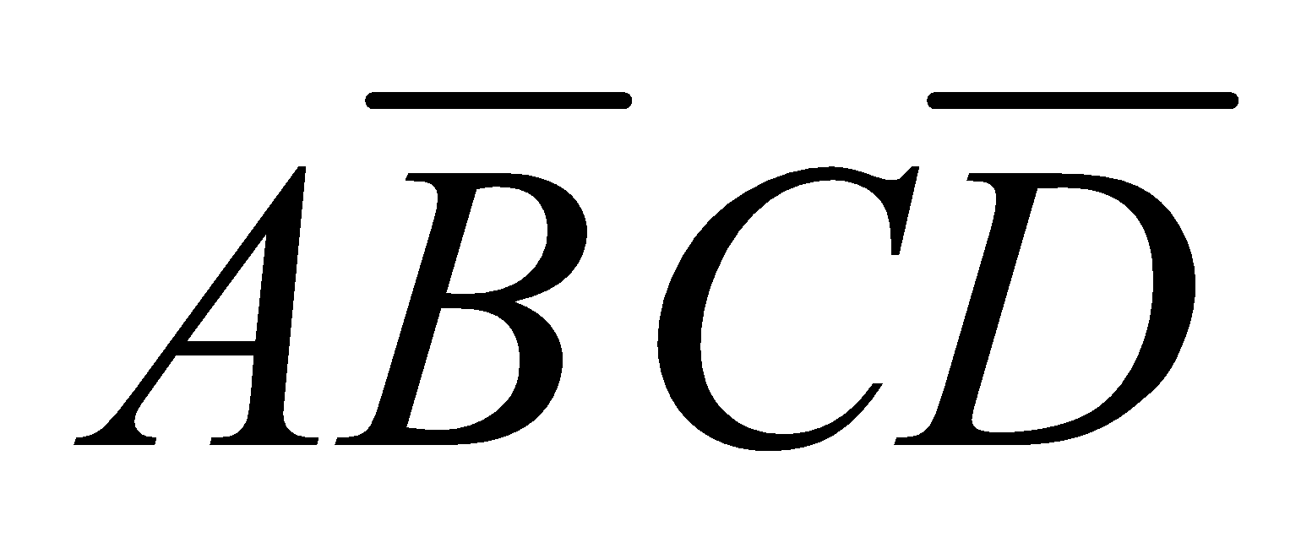
Binary Representation of a Standard Product Term
A standard product term is equal to 1 for only one combination of variable values.
Example: is equal to 1 when A=1, B=0, C=1, and D=0 as shown below
And this term is 0 for all other combinations of values for the variables.
Notes:
‹#›

Slide 13
Product-of-Sums (POS)
Notes:
‹#›

Slide 14
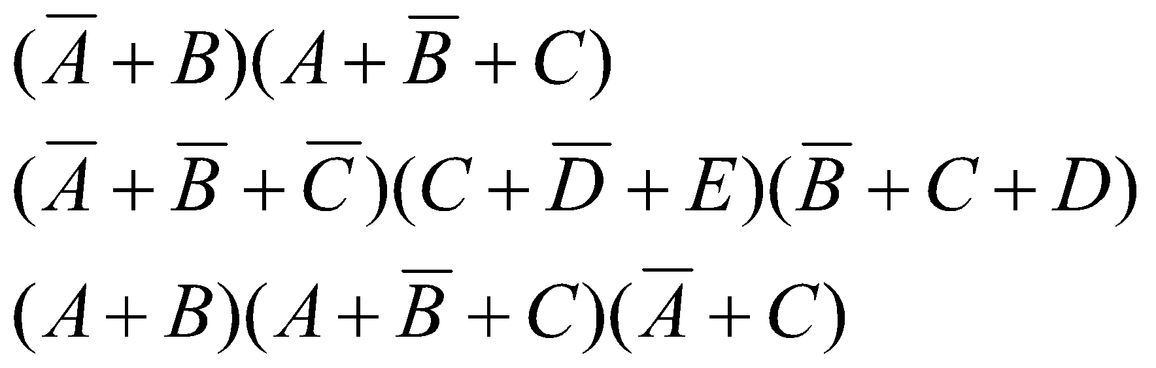
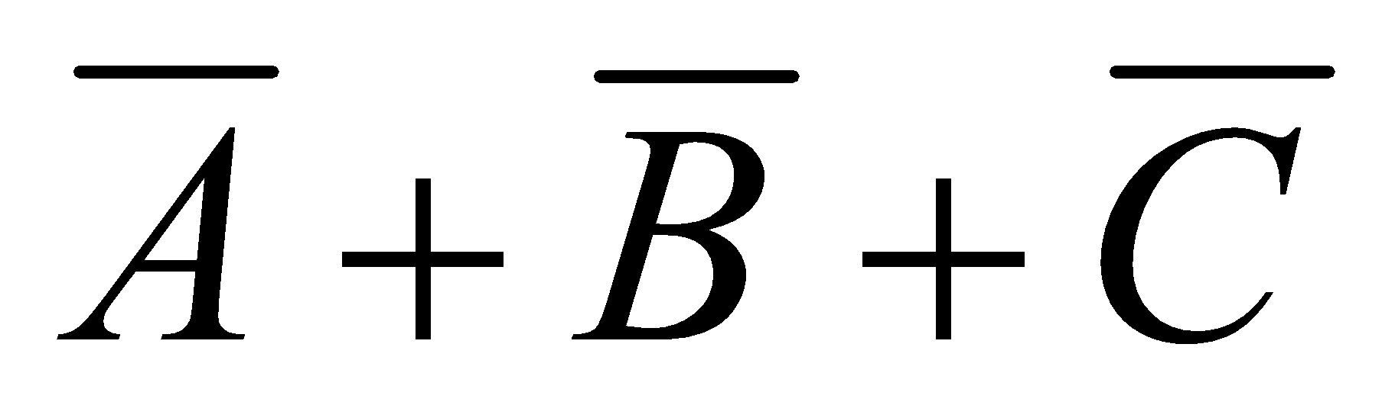
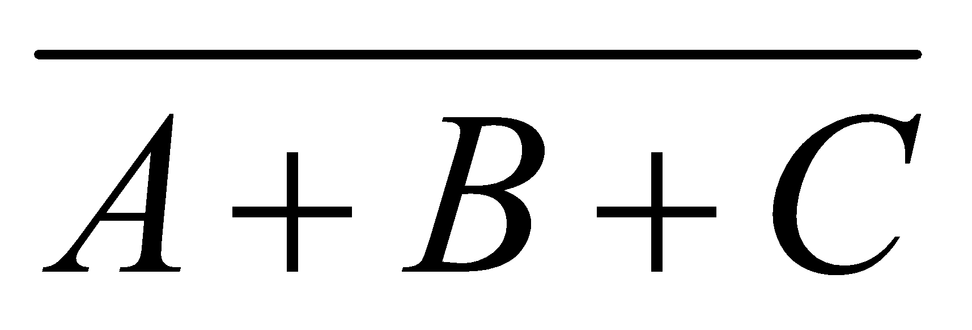
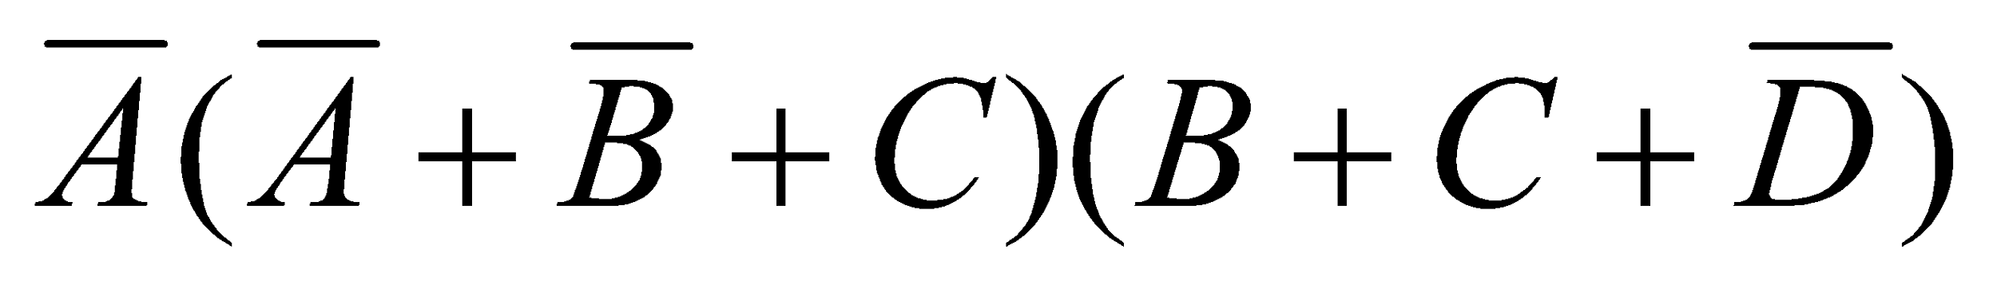
The Product-of-Sums (POS) Form
When two or more sum terms are multiplied, the result expression is a product-of-sums (POS):
Examples:
Also:
In a POS form, a single overbar cannot extend over more than one variable; however, more than one variable in a term can have an overbar:
example: is OK!
But not:
Notes:
‹#›

Slide 15

Implementation of a POS
X=(A+B)(B+C+D)(A+C)
OR/AND implementation
A
B
B
C
X
D
A
C
Notes:
‹#›

Slide 16
The Standard POS Form
A standard POS expression is one in which all the variables in the domain appear in each sum term in the expression.
Example:
Standard POS expressions are important in:
Constructing truth tables
The Karnaugh map simplification method
Notes:
‹#›

Slide 17
Converting a Sum Term to Standard POS
Step 1: Add to each nonstandard product term a term made up of the product of the missing variable and its complement. This results in two sum terms.
As you know, you can add 0 to anything without changing its value.
Step 2: Apply rule 12 🡪 A+BC=(A+B)(A+C).
Step 3: Repeat step 1 until all resulting sum terms contain all variable in the domain in either complemented or uncomplemented form.
Notes:
‹#›

Slide 18
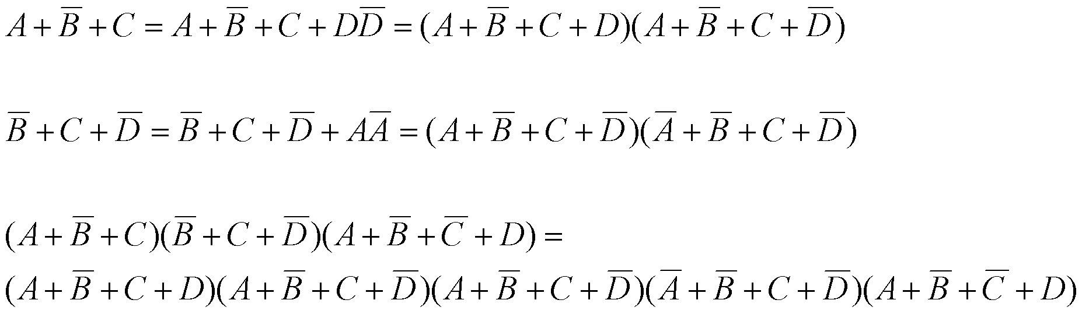
Converting a Sum Term to Standard POS (example)
Convert the following Boolean expression into standard POS form:
Notes:
‹#›

Slide 19
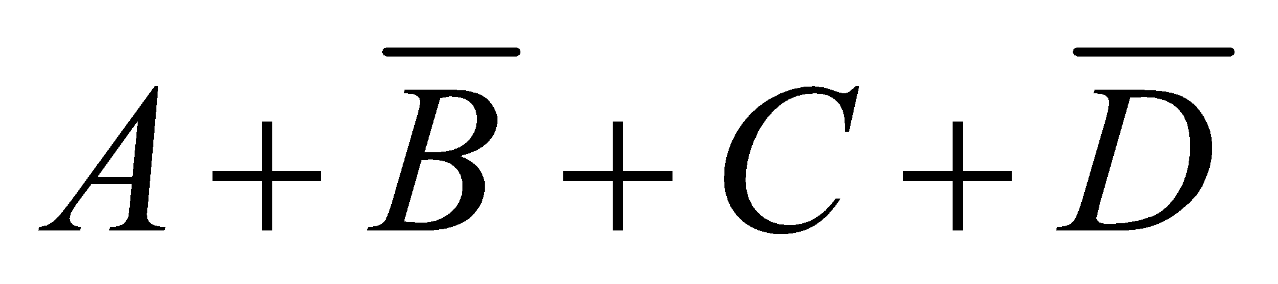
Binary Representation of a Standard Sum Term
A standard sum term is equal to 0 for only one combination of variable values.
Example: is equal to 0 when A=0, B=1, C=0, and D=1 as shown below
And this term is 1 for all other combinations of values for the variables.
Notes:
‹#›

Slide 20
SOP/POS
Notes:
‹#›

Slide 21
Converting Standard SOP to Standard POS
The Facts:
The binary values of the product terms in a given standard SOP expression are not present in the equivalent standard POS expression.
The binary values that are not represented in the SOP expression are present in the equivalent POS expression.
Notes:
‹#›

Slide 22
Converting Standard SOP to Standard POS
What can you use the facts?
Convert from standard SOP to standard POS.
How?
Step 1: Evaluate each product term in the SOP expression. That is, determine the binary numbers that represent the product terms.
Step 2: Determine all of the binary numbers not included in the evaluation in Step 1.
Step 3: Write the equivalent sum term for each binary number from Step 2 and express in POS form.
Notes:
‹#›

Slide 23
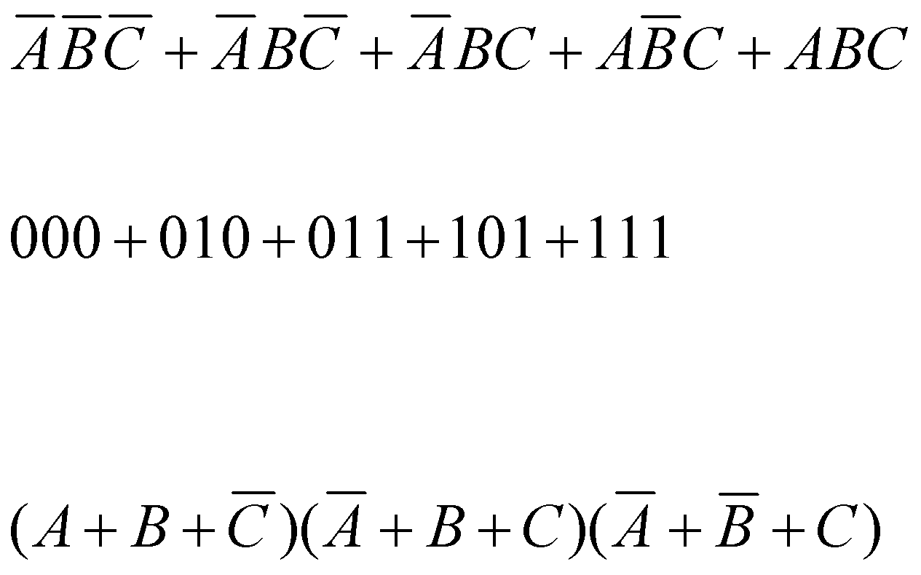
Converting Standard SOP to Standard POS (example)
Convert the SOP expression to an equivalent POS expression:
The evaluation is as follows:
There are 8 possible combinations. The SOP expression contains five of these, so the POS must contain the other 3 which are: 001, 100, and 110.
Notes:
‹#›

Slide 24
Boolean Expressions & Truth Tables
All standard Boolean expression can be easily converted into truth table format using binary values for each term in the expression.
Also, standard SOP or POS expression can be determined from the truth table.
Notes:
‹#›

Slide 25
Converting SOP Expressions to Truth Table Format
Recall the fact:
An SOP expression is equal to 1 only if at least one of the product term is equal to 1.
Constructing a truth table:
Step 1: List all possible combinations of binary values of the variables in the expression.
Step 2: Convert the SOP expression to standard form if it is not already.
Step 3: Place a 1 in the output column (X) for each binary value that makes the standard SOP expression a 1 and place 0 for all the remaining binary values.
Notes:
‹#›

Slide 26
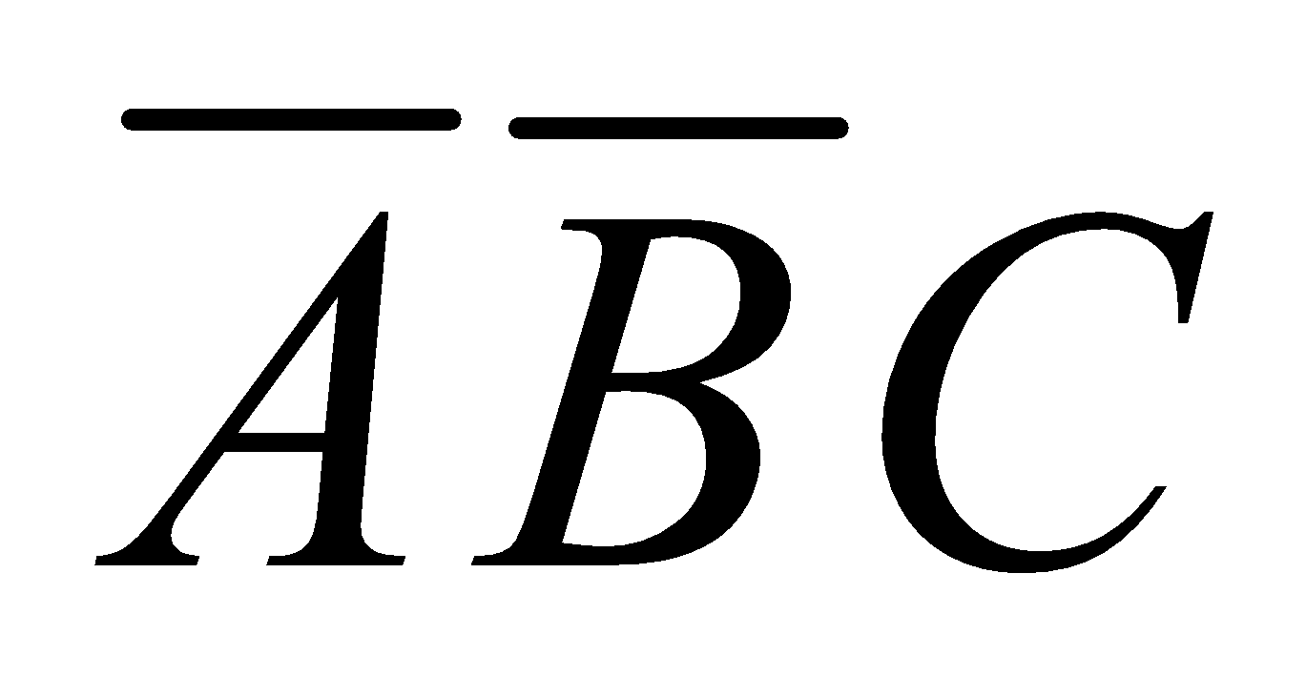
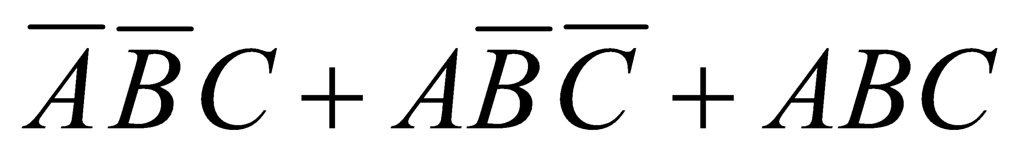
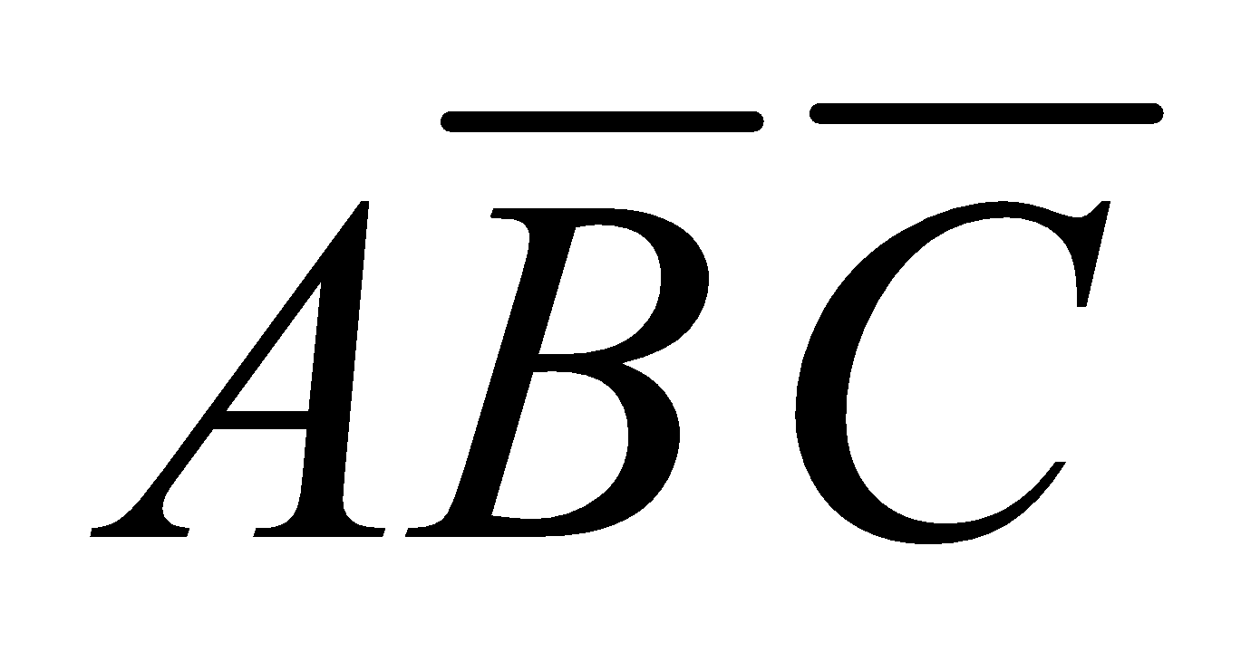
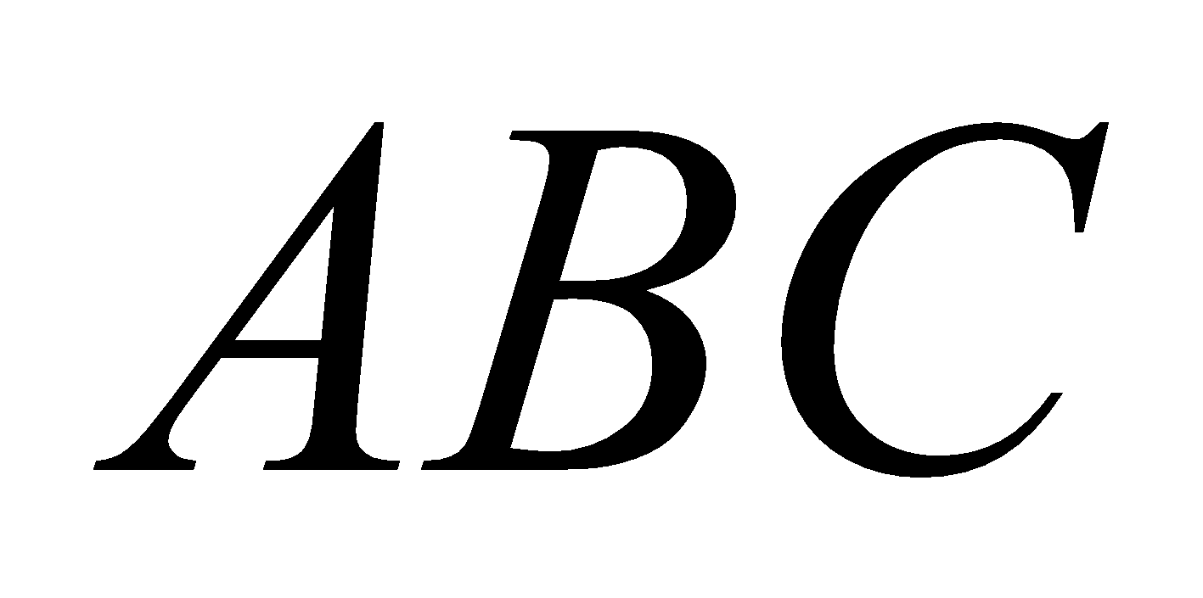
Converting SOP Expressions to Truth Table Format (example)
Develop a truth table for the standard SOP expression
Inputs |  |  | Output | Product Term
A | B | C | X
0 | 0 | 0 | 0
0 | 0 | 1 | 1
0 | 1 | 0 | 0
0 | 1 | 1 | 0
1 | 0 | 0 | 1
1 | 0 | 1 | 0
1 | 1 | 0 | 0
1 | 1 | 1 | 1
Inputs |  |  | Output | Product Term
A | B | C | X
0 | 0 | 0
0 | 0 | 1 | 1
0 | 1 | 0
0 | 1 | 1
1 | 0 | 0 | 1
1 | 0 | 1
1 | 1 | 0
1 | 1 | 1 | 1
Inputs |  |  | Output | Product Term
A | B | C | X
0 | 0 | 0
0 | 0 | 1
0 | 1 | 0
0 | 1 | 1
1 | 0 | 0
1 | 0 | 1
1 | 1 | 0
1 | 1 | 1
Inputs |  |  | Output | Product Term
A | B | C | X
0 | 0 | 0
0 | 0 | 1
0 | 1 | 0
0 | 1 | 1
1 | 0 | 0
1 | 0 | 1
1 | 1 | 0
1 | 1 | 1
Notes:
‹#›

Slide 27
Converting POS Expressions to Truth Table Format
Recall the fact:
A POS expression is equal to 0 only if at least one of the product term is equal to 0.
Constructing a truth table:
Step 1: List all possible combinations of binary values of the variables in the expression.
Step 2: Convert the POS expression to standard form if it is not already.
Step 3: Place a 0 in the output column (X) for each binary value that makes the standard POS expression a 0 and place 1 for all the remaining binary values.
Notes:
‹#›

Slide 28

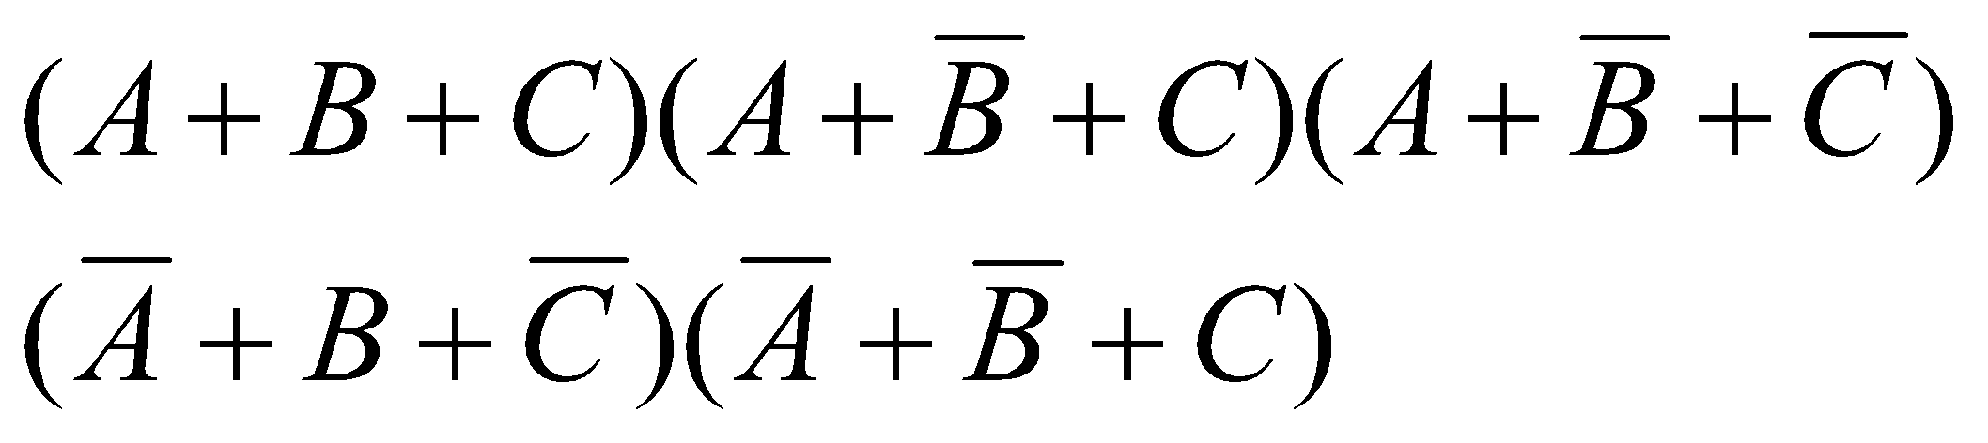
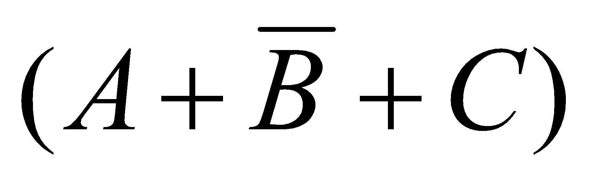
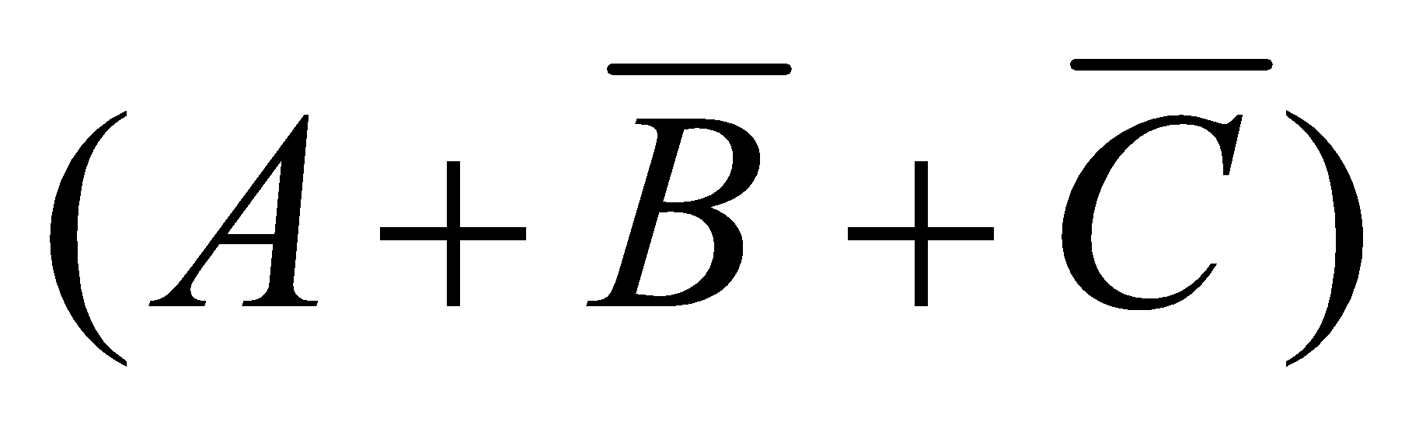
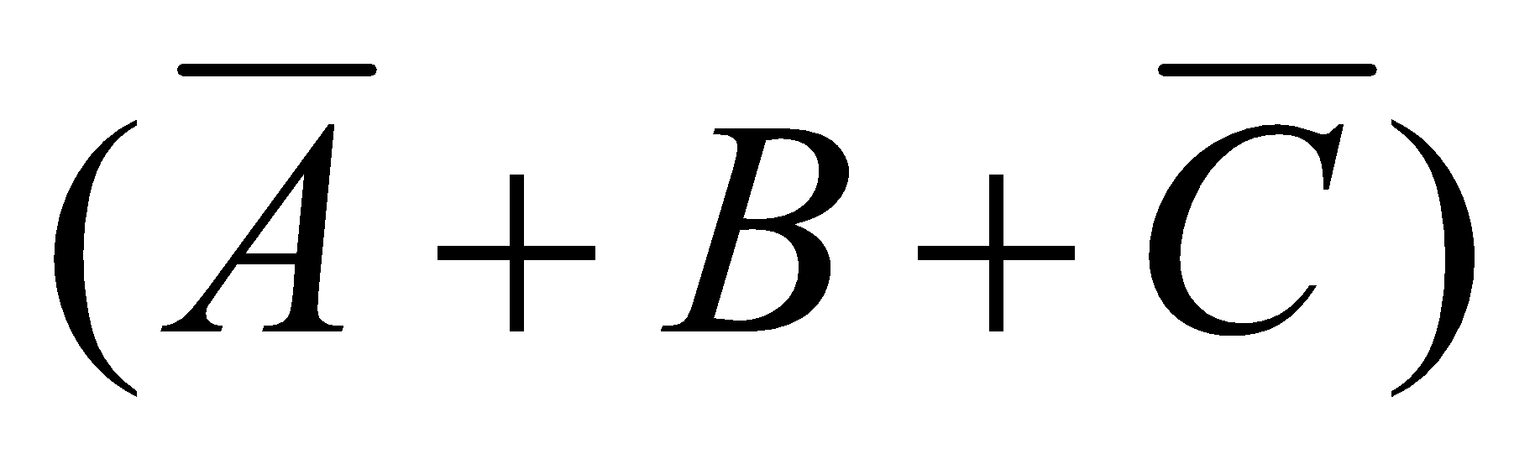
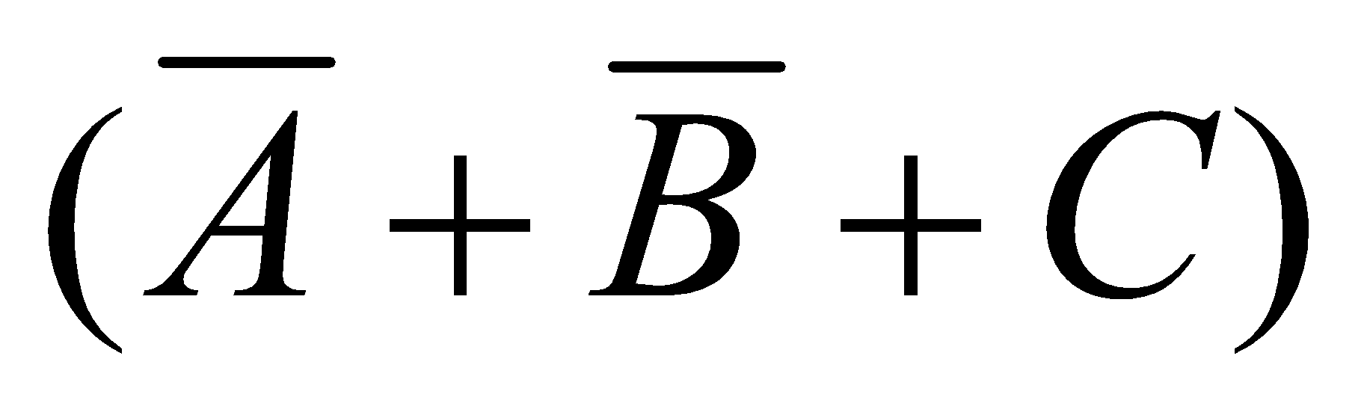
Converting POS Expressions to Truth Table Format (example)
Develop a truth table for the standard POS expression
Inputs |  |  | Output | Product Term
A | B | C | X
0 | 0 | 0 | 0
0 | 0 | 1 | 1
0 | 1 | 0 | 0
0 | 1 | 1 | 0
1 | 0 | 0 | 1
1 | 0 | 1 | 0
1 | 1 | 0 | 0
1 | 1 | 1 | 1
Inputs |  |  | Output | Product Term
A | B | C | X
0 | 0 | 0 | 0
0 | 0 | 1
0 | 1 | 0 | 0
0 | 1 | 1 | 0
1 | 0 | 0
1 | 0 | 1 | 0
1 | 1 | 0 | 0
1 | 1 | 1
Inputs |  |  | Output | Product Term
A | B | C | X
0 | 0 | 0
0 | 0 | 1
0 | 1 | 0
0 | 1 | 1
1 | 0 | 0
1 | 0 | 1
1 | 1 | 0
1 | 1 | 1
Inputs |  |  | Output | Product Term
A | B | C | X
0 | 0 | 0
0 | 0 | 1
0 | 1 | 0
0 | 1 | 1
1 | 0 | 0
1 | 0 | 1
1 | 1 | 0
1 | 1 | 1
Notes:
‹#›

Slide 29
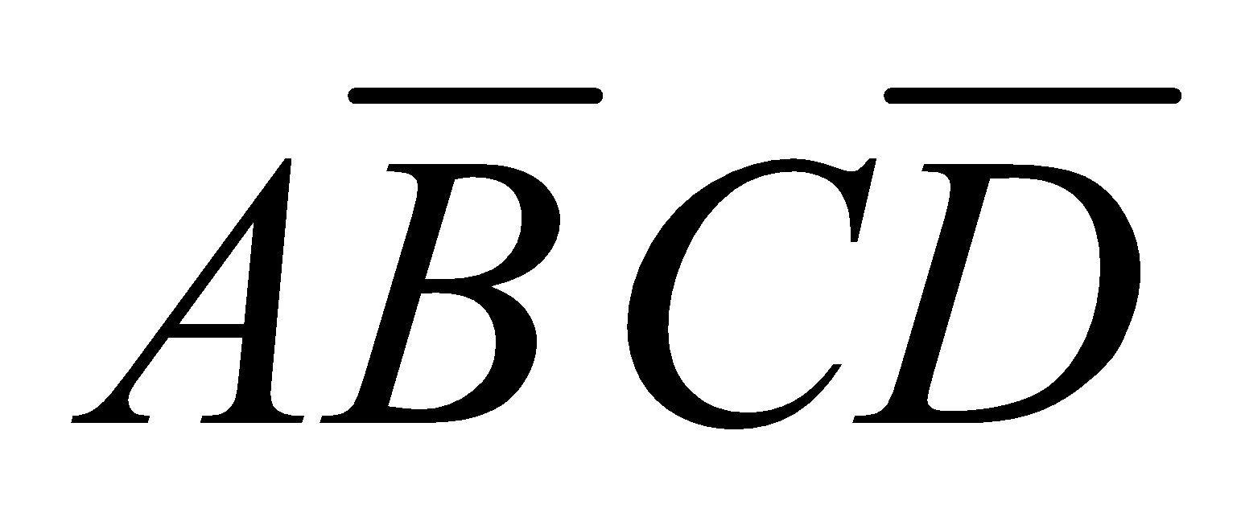
Determining Standard Expression from a Truth Table
To determine the standard SOP expression represented by a truth table.
Instructions:
Step 1: List the binary values of the input variables for which the output is 1.
Step 2: Convert each binary value to the corresponding product term by replacing:
each 1 with the corresponding variable, and
each 0 with the corresponding variable complement.
Example: 1010 🡪
Notes:
‹#›

Slide 30
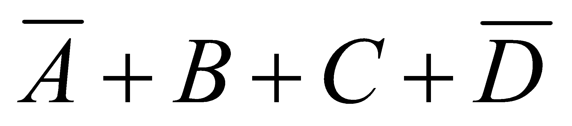
Determining Standard Expression from a Truth Table
To determine the standard POS expression represented by a truth table.
Instructions:
Step 1: List the binary values of the input variables for which the output is 0.
Step 2: Convert each binary value to the corresponding product term by replacing:
each 1 with the corresponding variable complement, and
each 0 with the corresponding variable.
Example: 1001 🡪
Notes:
‹#›

Slide 31
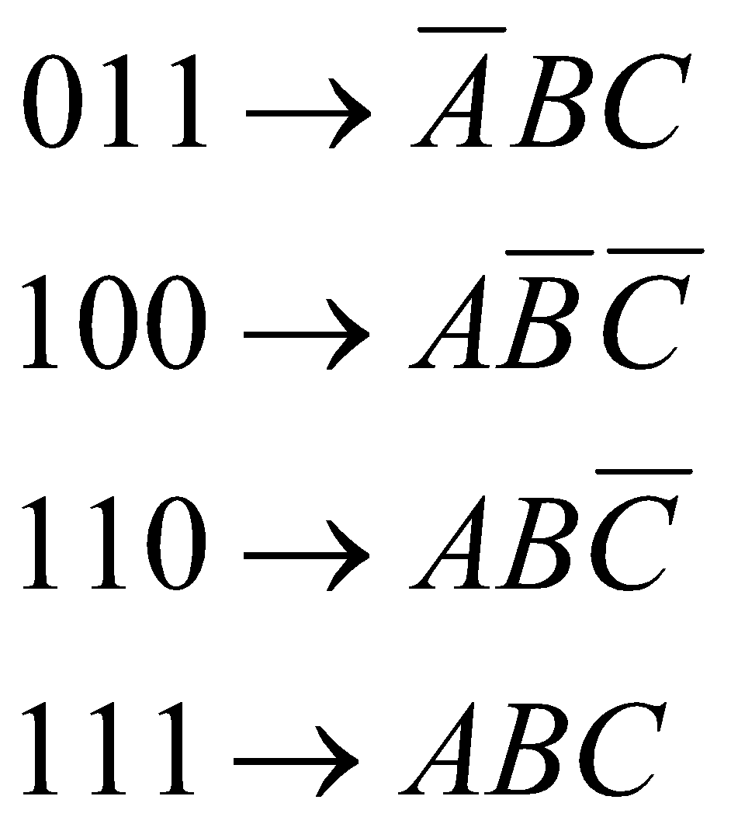
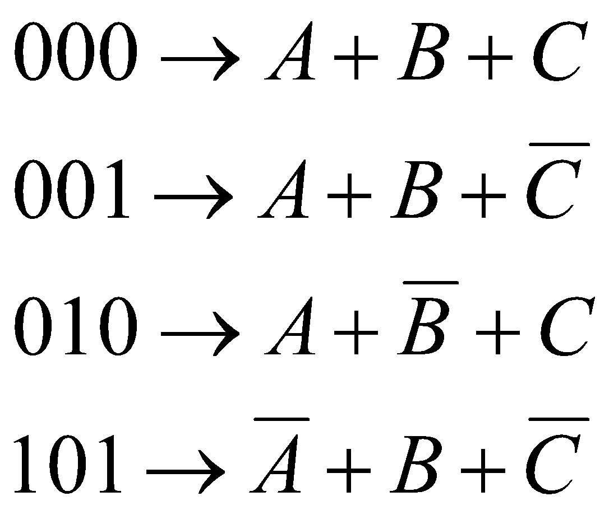
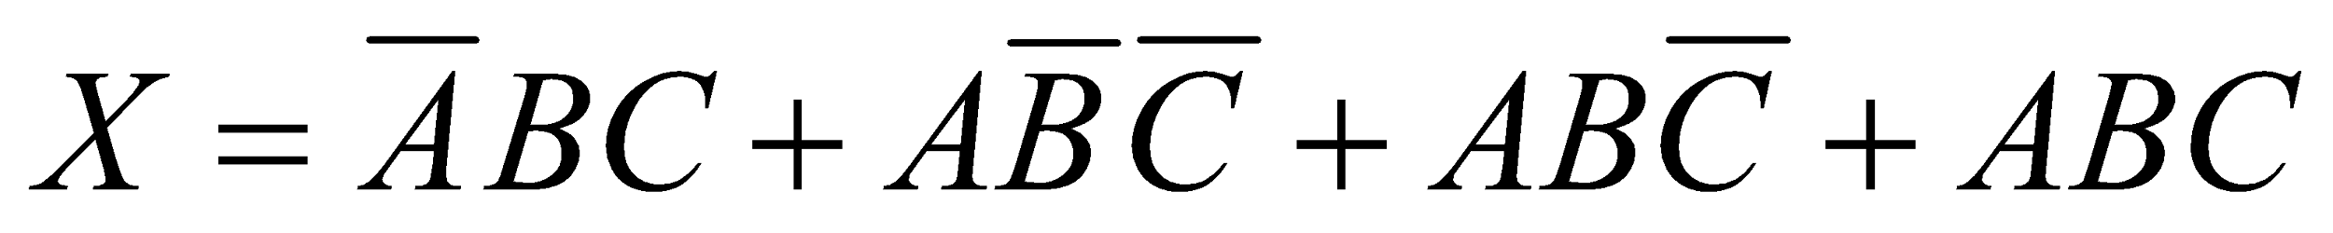
Determining Standard Expression from a Truth Table (example)
I/P |  |  | O/P
A | B | C | X
0 | 0 | 0 | 0
0 | 0 | 1 | 0
0 | 1 | 0 | 0
0 | 1 | 1 | 1
1 | 0 | 0 | 1
1 | 0 | 1 | 0
1 | 1 | 0 | 1
1 | 1 | 1 | 1
There are four 1s in the output and the corresponding binary value are 011, 100, 110, and 111.
There are four 0s in the output and the corresponding binary value are 000, 001, 010, and 101.
SOP
POS
Notes:
‹#›

Slide 32
The Karnaugh Map
Notes:
‹#›

Slide 33
The Karnaugh Map
Feel a little difficult using Boolean algebra laws, rules, and theorems to simplify logic?
A K-map provides a systematic method for simplifying Boolean expressions and, if properly used, will produce the simplest SOP or POS expression possible, known as the minimum expression.
Notes:
‹#›

Slide 34
What is K-Map
It’s similar to truth table; instead of being organized (i/p and o/p) into columns and rows, the K-map is an array of cells in which each cell represents a binary value of the input variables.
The cells are arranged in a way so that simplification of a given expression is simply a matter of properly grouping the cells.
K-maps can be used for expressions with 2, 3, 4, and 5 variables.
3 and 4 variables will be discussed to illustrate the principles.
Notes:
‹#›

Slide 35
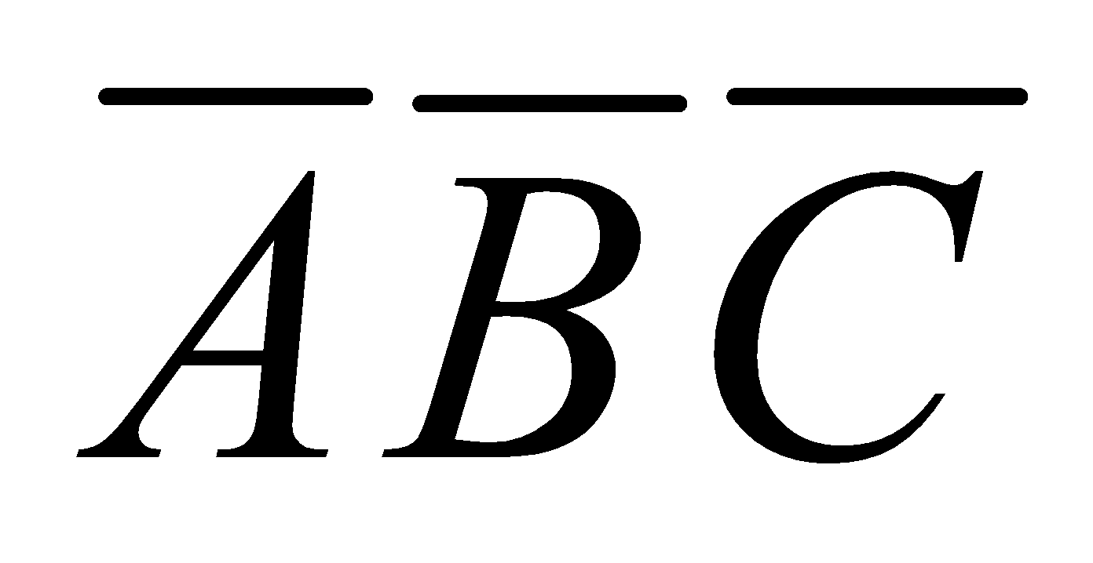
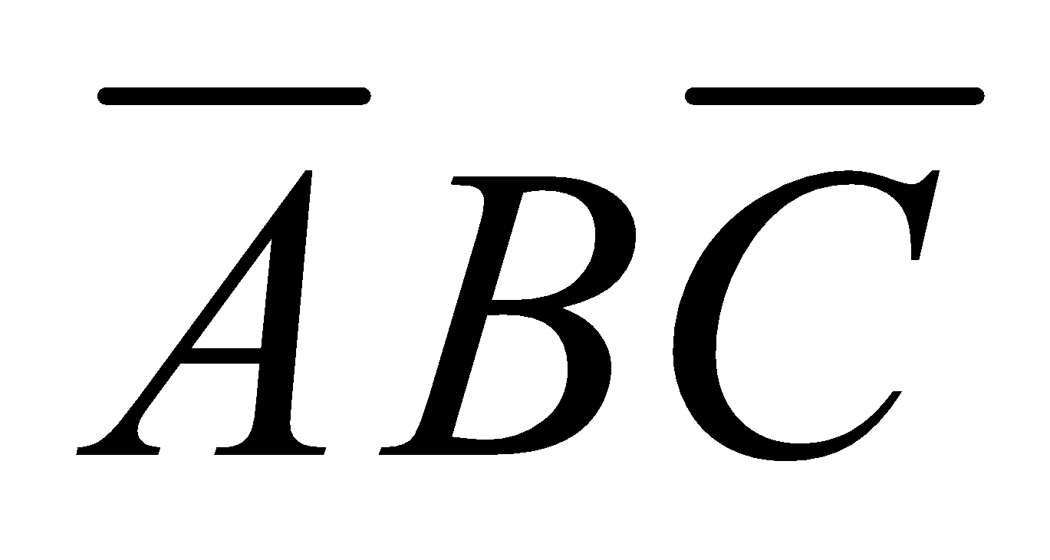
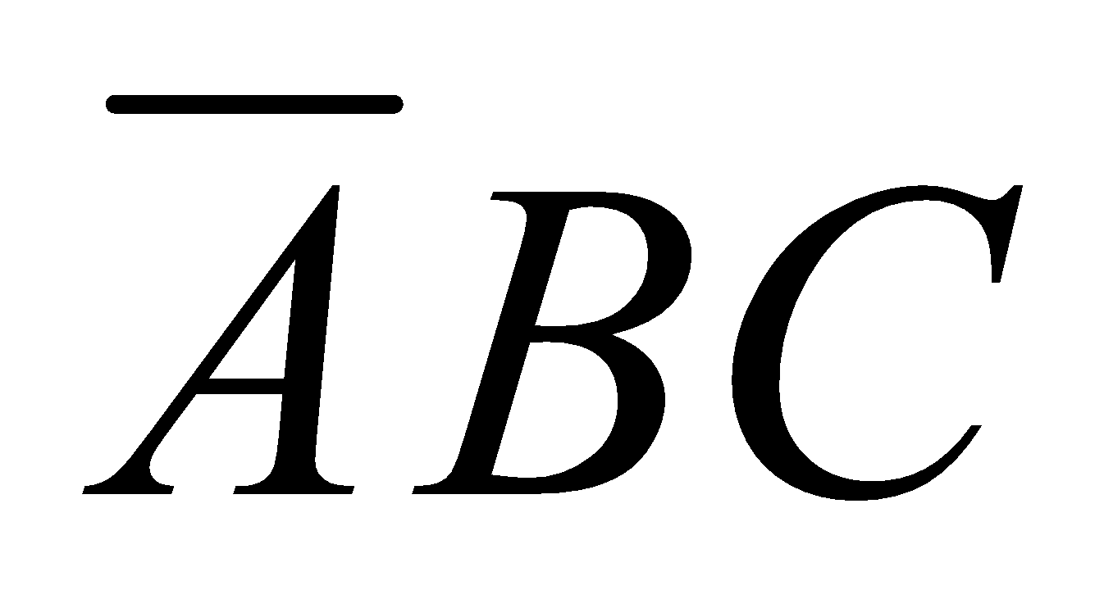
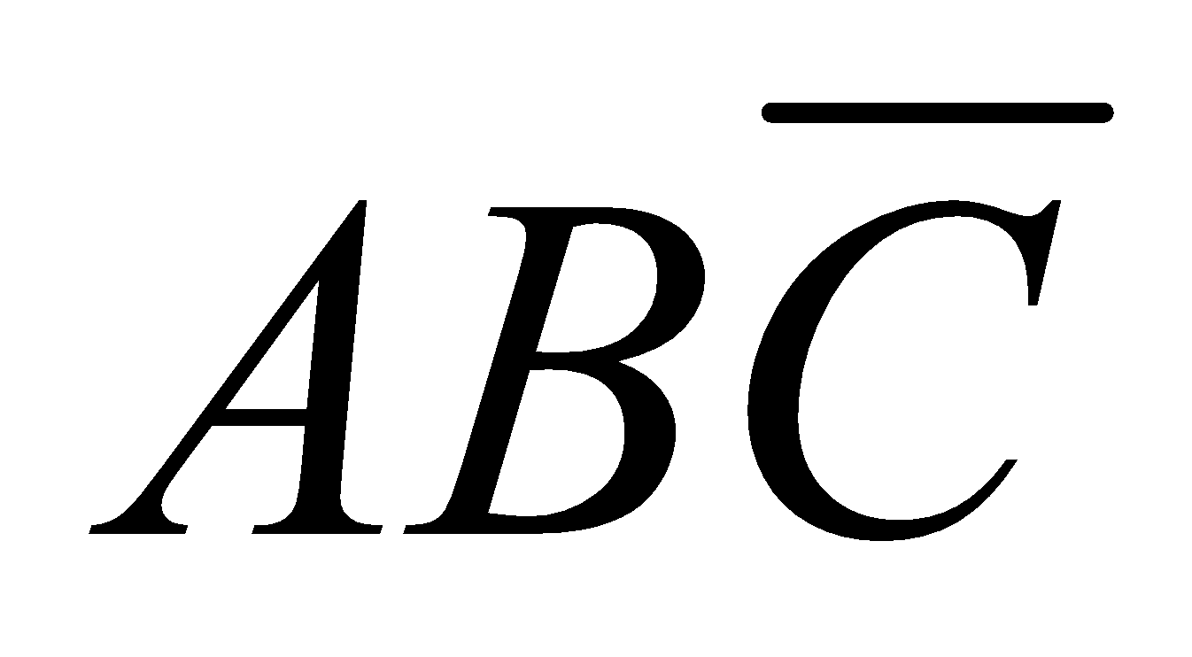
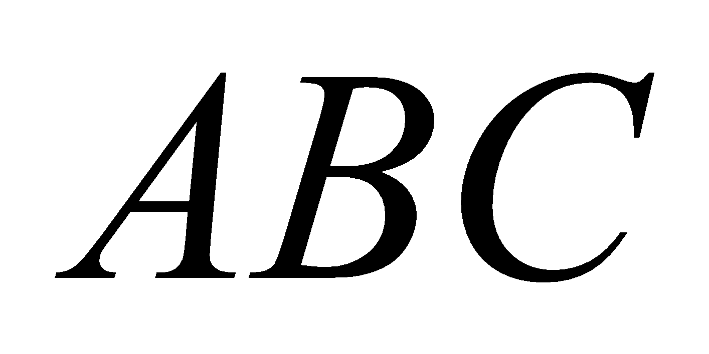
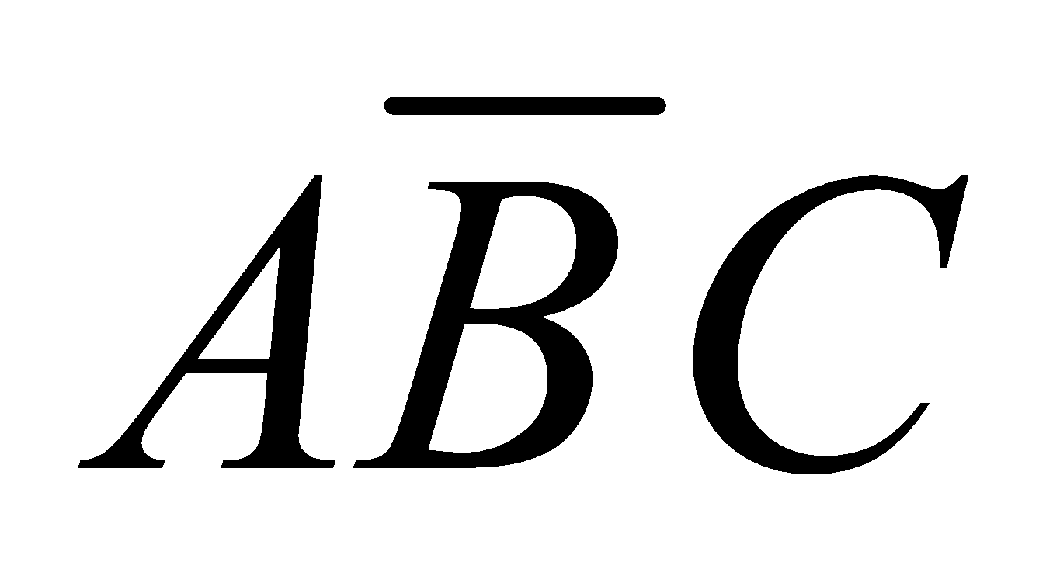
The 3 Variable K-Map
There are 8 cells as shown:
C AB | 0 | 1
00
01
11
10
Notes:
‹#›

Slide 36
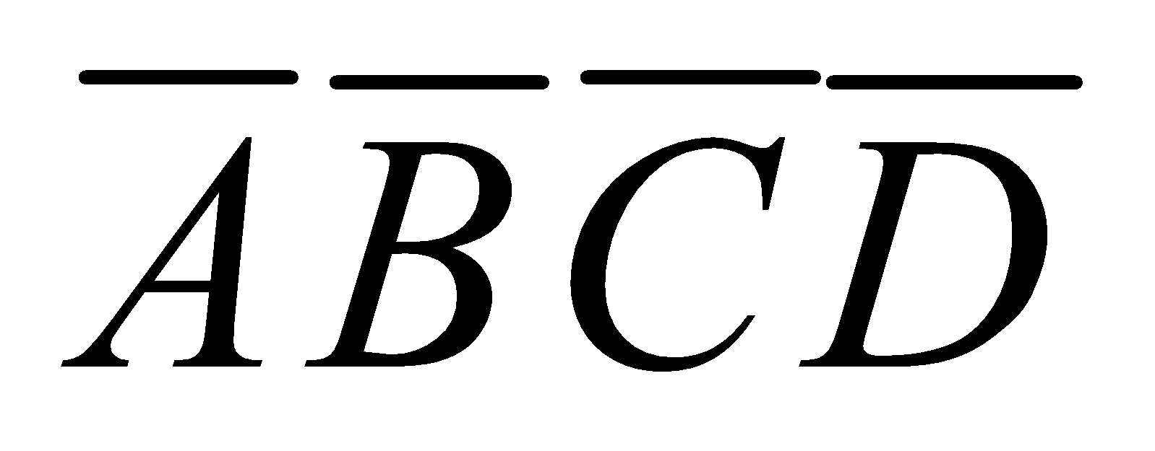
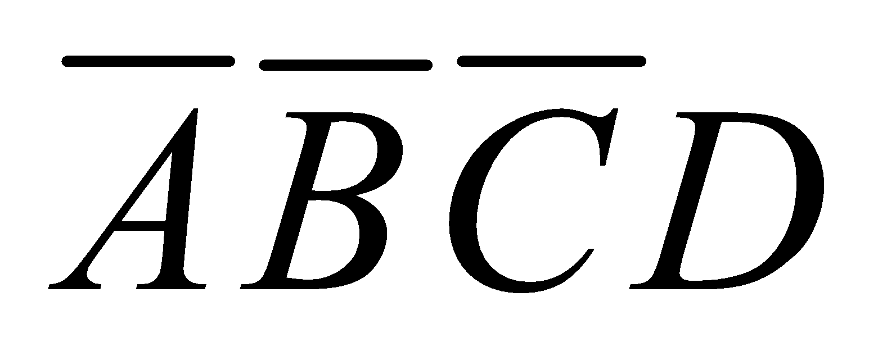
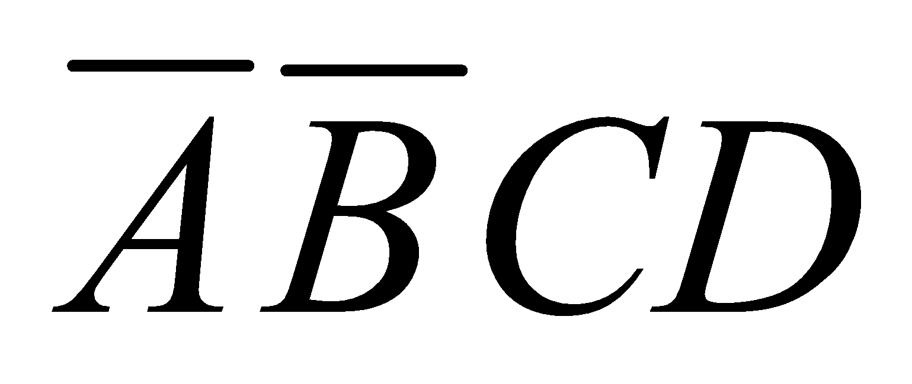
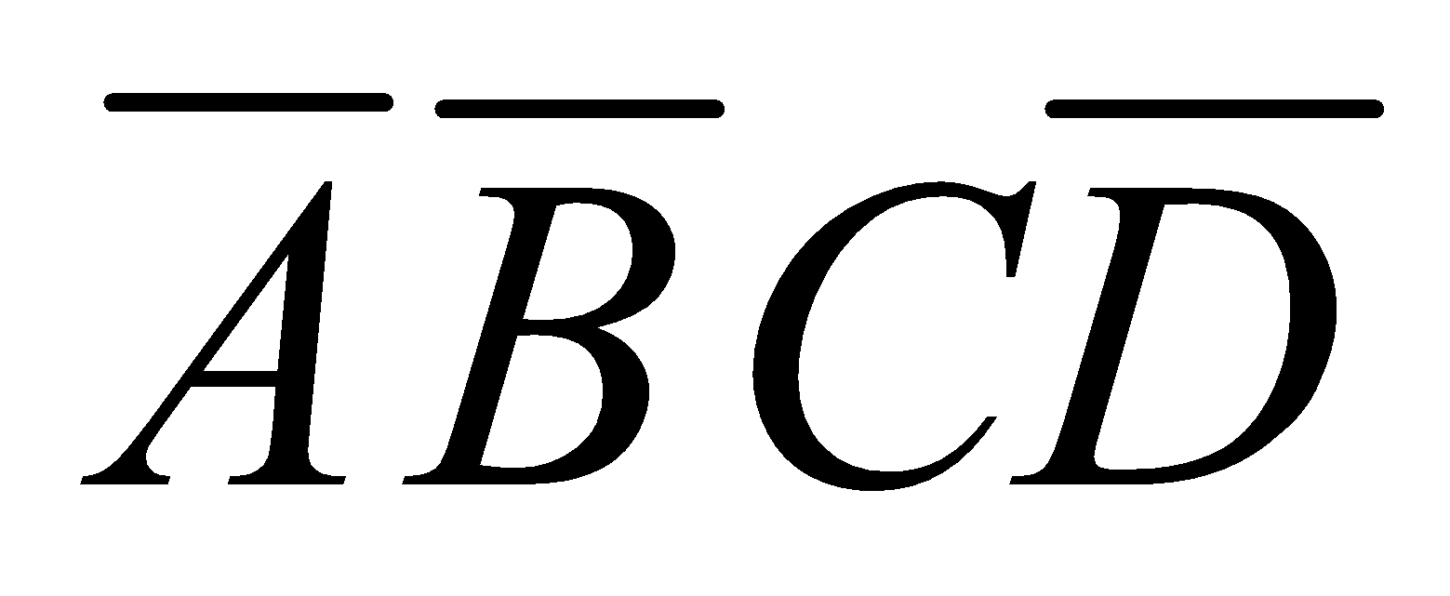
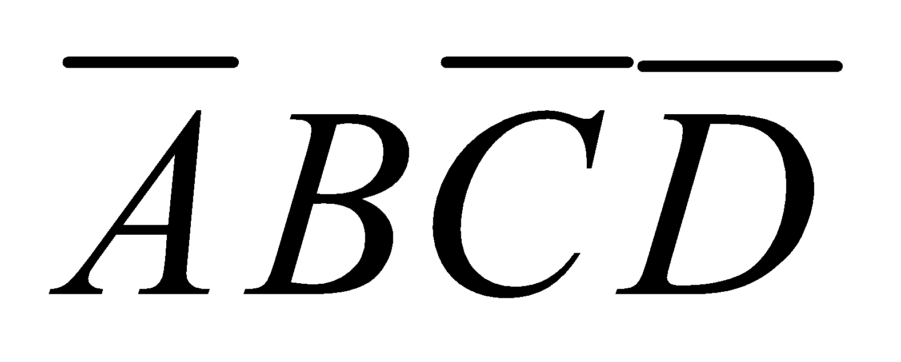
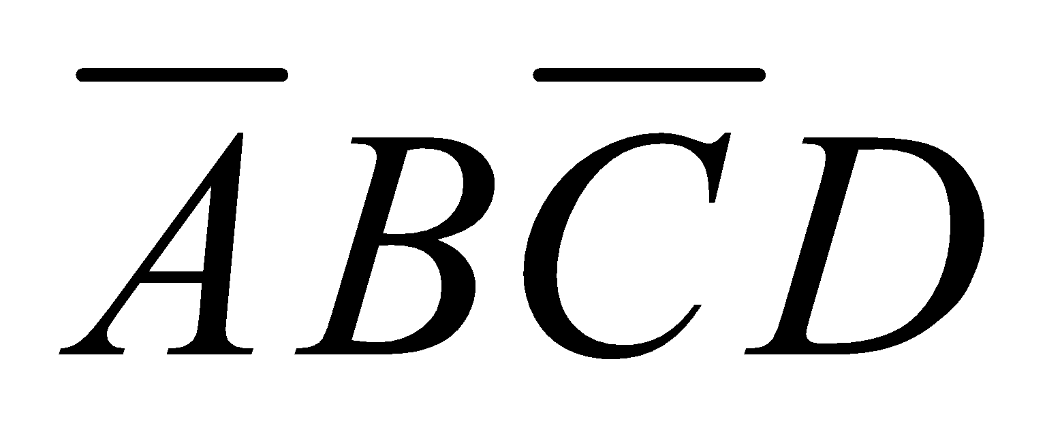
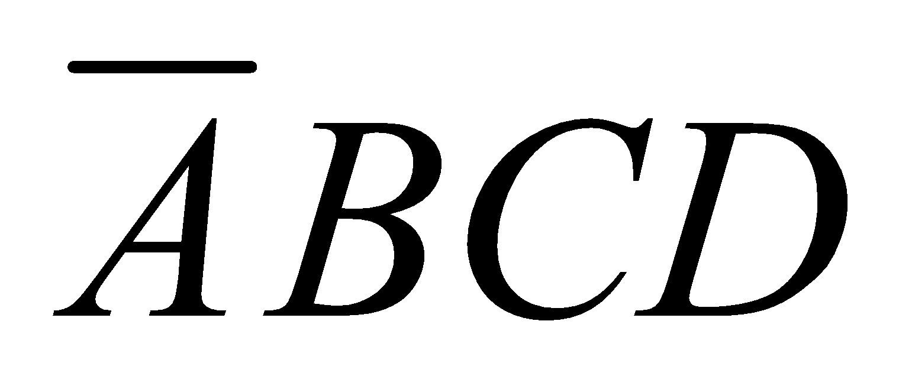
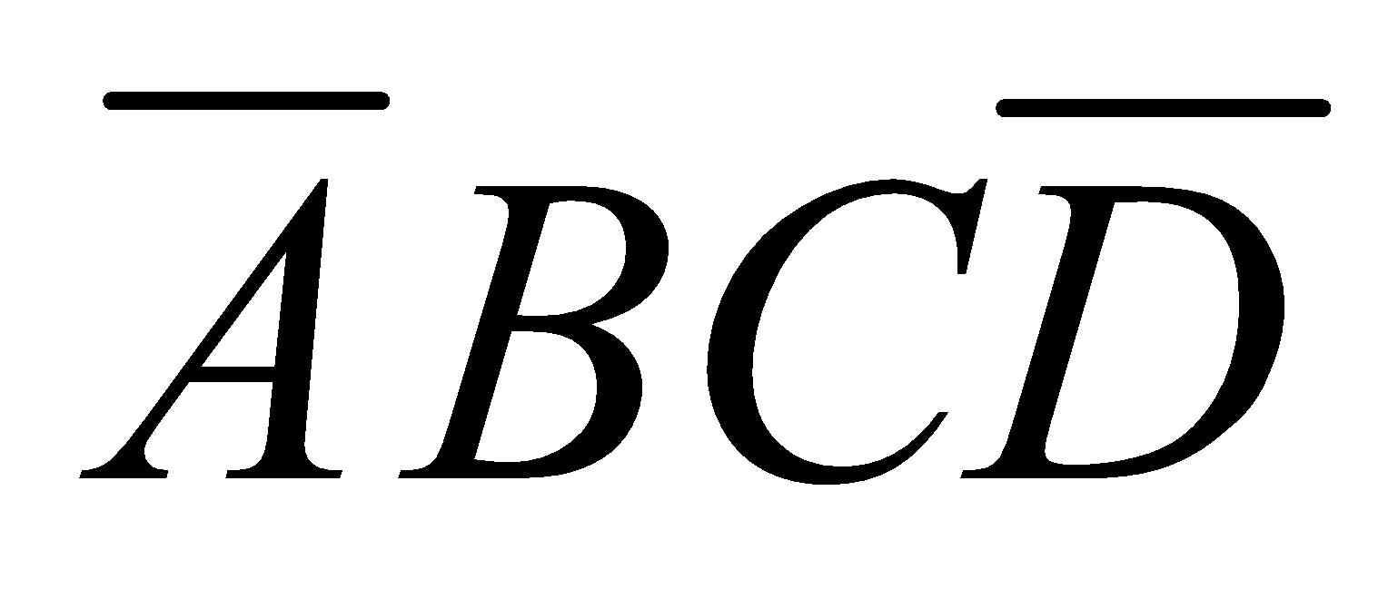
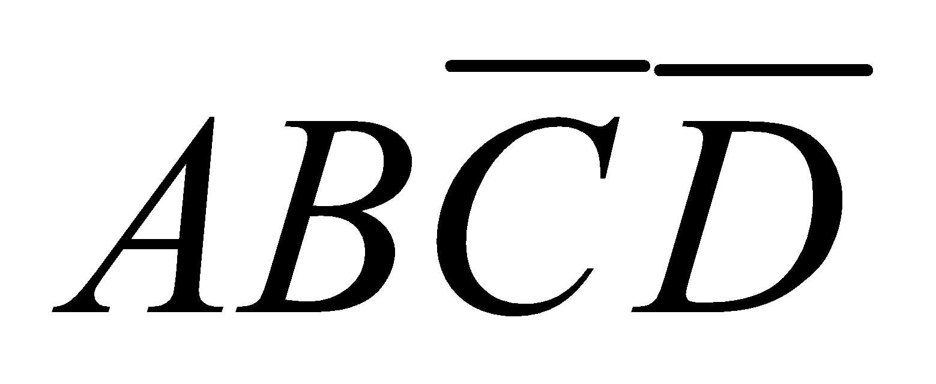
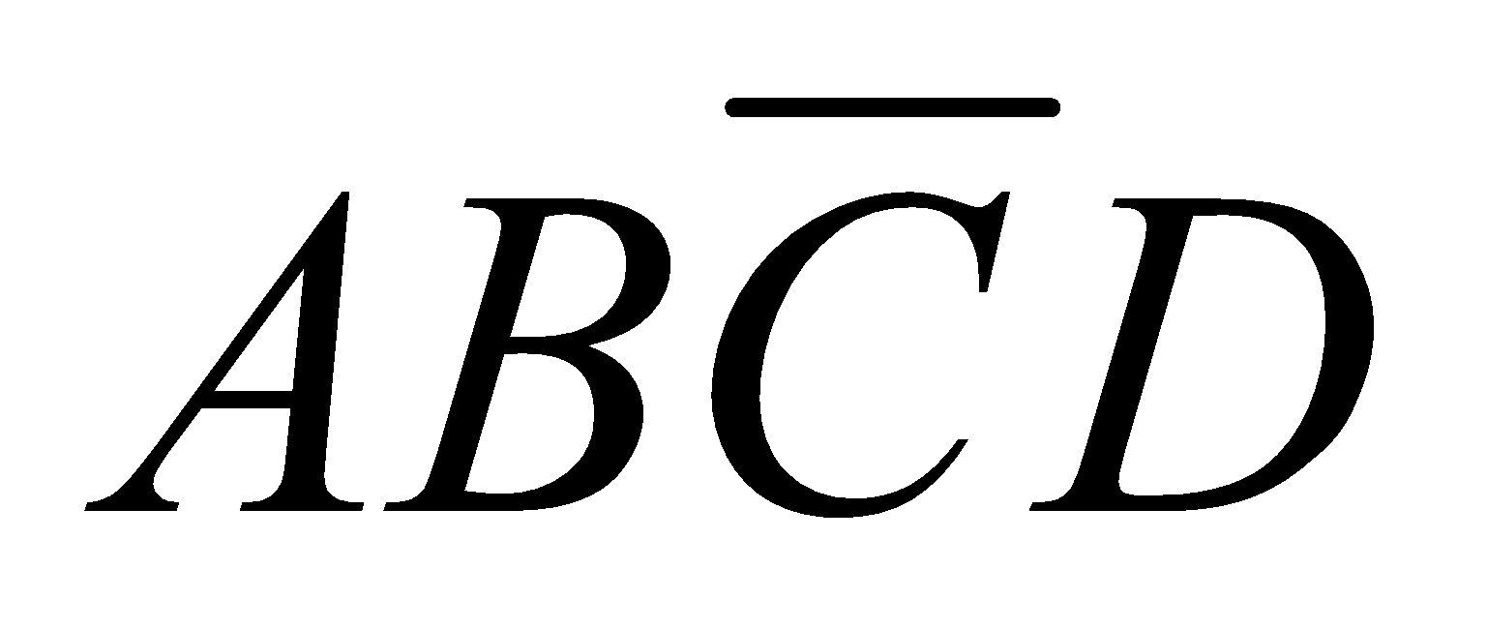

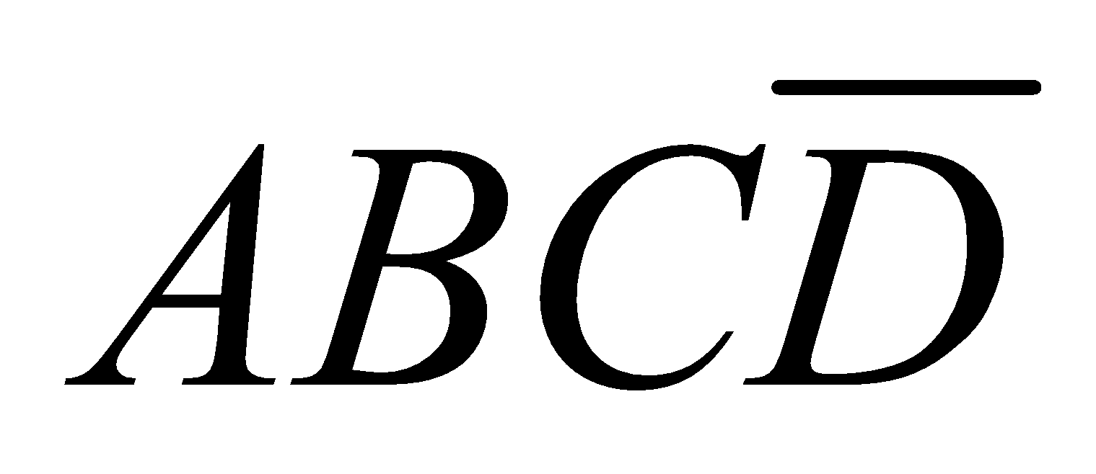
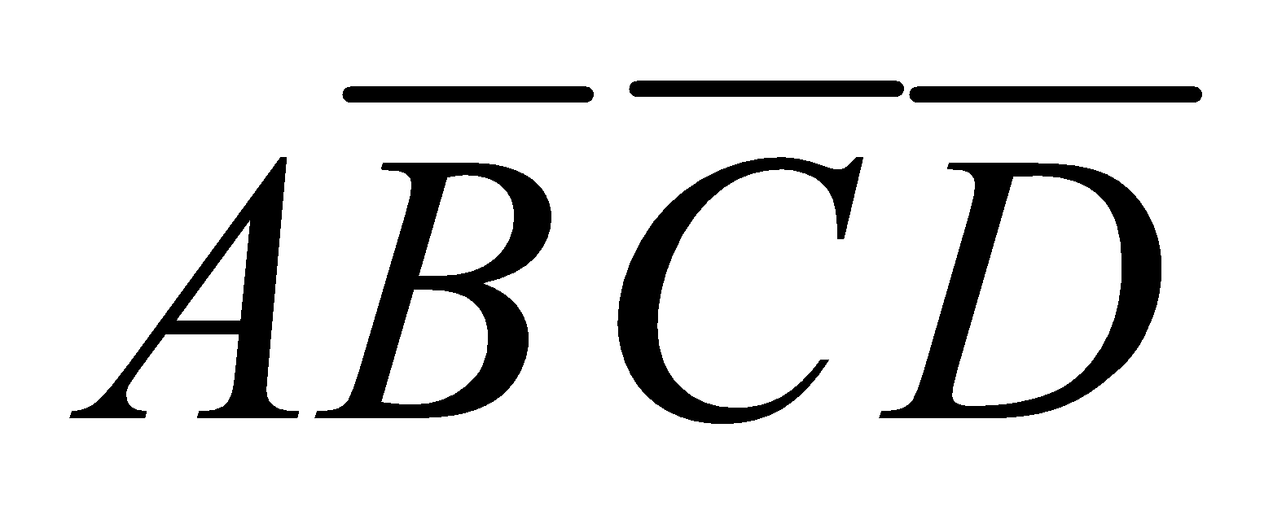
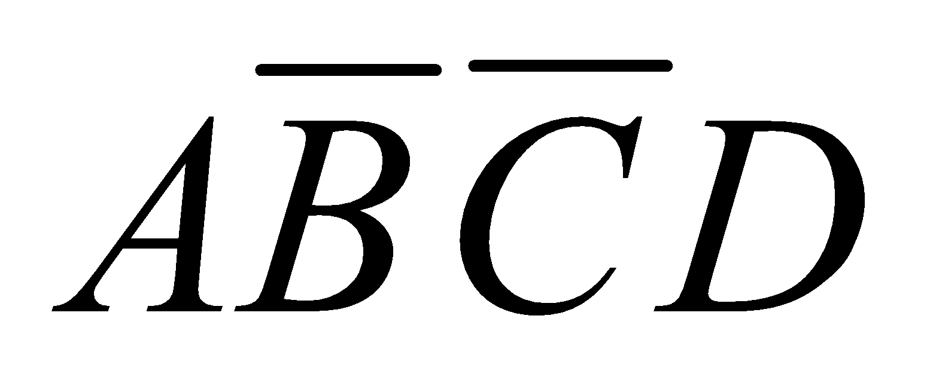
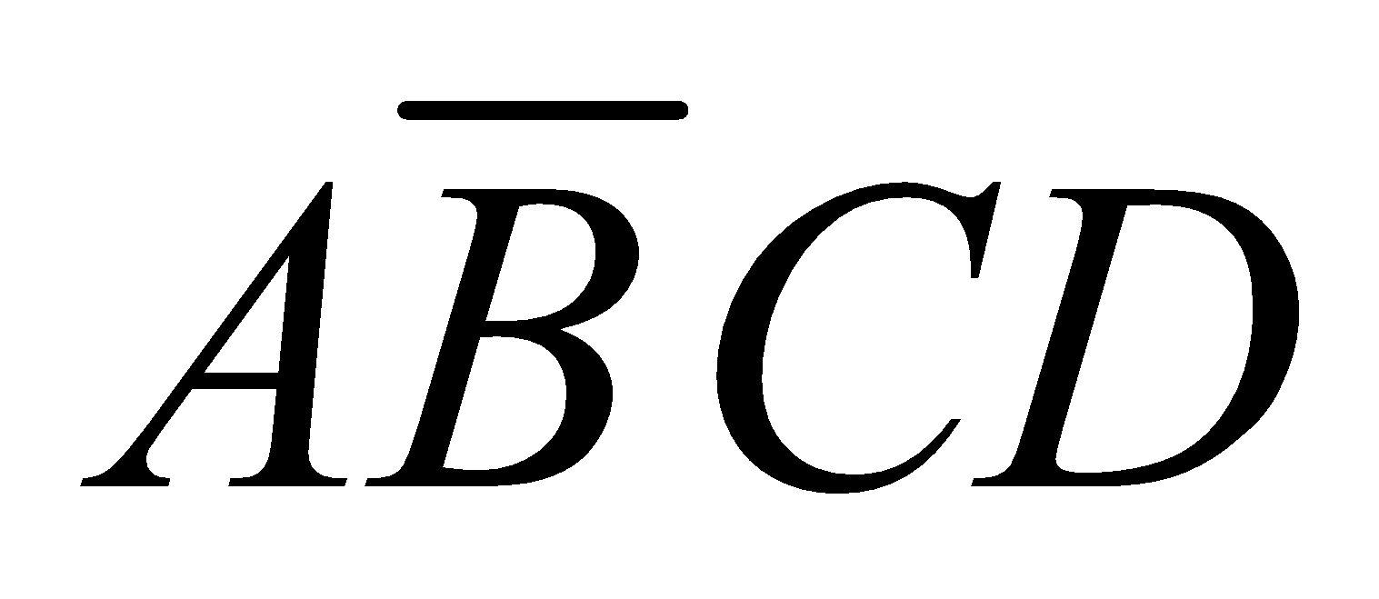

The 4-Variable K-Map
CD AB | 00 | 01 | 11 | 10
00
01
11
10
Notes:
‹#›

Slide 37
Cell Adjacency
CD AB | 00 | 01 | 11 | 10
00
01
11
10
Notes:
‹#›

Slide 38
K-Map SOP Minimization
The K-Map is used for simplifying Boolean expressions to their minimal form.
A minimized SOP expression contains the fewest possible terms with fewest possible variables per term.
Generally, a minimum SOP expression can be implemented with fewer logic gates than a standard expression.
Notes:
‹#›

Slide 39

Mapping a Standard SOP Expression
For an SOP expression in standard form:
A 1 is placed on the K-map for each product term in the expression.
Each 1 is placed in a cell corresponding to the value of a product term.
Example: for the product term , a 1 goes in the 101 cell on a 3-variable map.
C AB | 0 | 1
00
01
11
10
1
Notes:
‹#›

Slide 40


Mapping a Standard SOP Expression (full example)
The expression:
C AB | 0 | 1
00
01
11
10
000
001
110
100
1
1
Practice:
1
1
Notes:
‹#›

Slide 41
Mapping a Nonstandard SOP Expression
A Boolean expression must be in standard form before you use a K-map.
If one is not in standard form, it must be converted.
You may use the procedure mentioned earlier or use numerical expansion.
Notes:
‹#›

Slide 42





Mapping a Nonstandard SOP Expression
Numerical Expansion of a Nonstandard product term
Assume that one of the product terms in a certain 3-variable SOP expression is .
It can be expanded numerically to standard form as follows:
Step 1: Write the binary value of the two variables and attach a 0 for the missing variable : 100.
Step 2: Write the binary value of the two variables and attach a 1 for the missing variable : 100.
The two resulting binary numbers are the values of the standard SOP terms 🡪 and .
If the assumption that one of the product term in a 3-variable expression is B. How can we do this?
Notes:
‹#›

Slide 43

Mapping a Nonstandard SOP Expression
Map the following SOP expressions on K-maps:
Notes:
‹#›

Slide 44
K-Map Simplification of SOP Expressions
After an SOP expression has been mapped, we can do the process of minimization:
Grouping the 1s
Determining the minimum SOP expression from the map
Notes:
‹#›

Slide 45
Grouping the 1s
You can group 1s on the K-map according to the following rules by enclosing those adjacent cells containing 1s.
The goal is to maximize the size of the groups and to minimize the number of groups.
Notes:
‹#›

Slide 46
Grouping the 1s (rules)
A group must contain either 1,2,4,8,or 16 cells (depending on number of variables in the expression)
Each cell in a group must be adjacent to one or more cells in that same group, but all cells in the group do not have to be adjacent to each other.
Always include the largest possible number of 1s in a group in accordance with rule 1.
Each 1 on the map must be included in at least one group. The 1s already in a group can be included in another group as long as the overlapping groups include noncommon 1s.
Notes:
‹#›

Slide 47
Grouping the 1s (example)
C AB | 0 | 1
00 | 1
01 |  | 1
11 | 1 | 1
10
C AB | 0 | 1
00 | 1 | 1
01 | 1
11 |  | 1
10 | 1 | 1
Notes:
‹#›

Slide 48
Grouping the 1s (example)
CD AB | 00 | 01 | 11 | 10
00 | 1 | 1
01 | 1 | 1 | 1 | 1
11
10 |  | 1 | 1
CD AB | 00 | 01 | 11 | 10
00 | 1 |  |  | 1
01 | 1 | 1 |  | 1
11 | 1 | 1 |  | 1
10 | 1 |  | 1 | 1
Notes:
‹#›

Slide 49
Determining the Minimum SOP Expression from the Map
The following rules are applied to find the minimum product terms and the minimum SOP expression:
Group the cells that have 1s. Each group of cell containing 1s creates one product term composed of all variables that occur in only one form (either complemented or complemented) within the group. Variables that occur both complemented and uncomplemented within the group are eliminated 🡪 called contradictory variables.
Notes:
‹#›

Slide 50
Determining the Minimum SOP Expression from the Map
Determine the minimum product term for each group.
For a 3-variable map:
A 1-cell group yields a 3-variable product term
A 2-cell group yields a 2-variable product term
A 4-cell group yields a 1-variable product term
An 8-cell group yields a value of 1 for the expression.
For a 4-variable map:
A 1-cell group yields a 4-variable product term
A 2-cell group yields a 3-variable product term
A 4-cell group yields a 2-variable product term
An 8-cell group yields a a 1-variable product term
A 16-cell group yields a value of 1 for the expression.
Notes:
‹#›

Slide 51
Determining the Minimum SOP Expression from the Map
When all the minimum product terms are derived from the K-map, they are summed to form the minimum SOP expression.
Notes:
‹#›

Slide 52




Determining the Minimum SOP Expression from the Map (example)
CD AB | 00 | 01 | 11 | 10
00 |  |  | 1 | 1
01 | 1 | 1 | 1 | 1
11 | 1 | 1 | 1 | 1
10 |  | 1
Notes:
‹#›

Slide 53


Determining the Minimum SOP Expression from the Map (exercises)
C AB | 0 | 1
00 | 1
01 |  | 1
11 | 1 | 1
10
C AB | 0 | 1
00 | 1 | 1
01 | 1
11 |  | 1
10 | 1 | 1
Notes:
‹#›

Slide 54


Determining the Minimum SOP Expression from the Map (exercises)
CD AB | 00 | 01 | 11 | 10
00 | 1 | 1
01 | 1 | 1 | 1 | 1
11
10 |  | 1 | 1
CD AB | 00 | 01 | 11 | 10
00 | 1 |  |  | 1
01 | 1 | 1 |  | 1
11 | 1 | 1 |  | 1
10 | 1 |  | 1 | 1
Notes:
‹#›

Slide 55



Practicing K-Map (SOP)
Notes:
‹#›

Slide 56
Mapping Directly from a Truth Table
I/P |  |  | O/P
A | B | C | X
0 | 0 | 0 | 1
0 | 0 | 1 | 0
0 | 1 | 0 | 0
0 | 1 | 1 | 0
1 | 0 | 0 | 1
1 | 0 | 1 | 0
1 | 1 | 0 | 1
1 | 1 | 1 | 1
C AB | 0 | 1
00
01
11
10
1
1
1
1
Notes:
‹#›

Slide 57
“Don’t Care” Conditions
Sometimes a situation arises in which some input variable combinations are not allowed, i.e. BCD code:
There are six invalid combinations: 1010, 1011, 1100, 1101, 1110, and 1111.
Since these unallowed states will never occur in an application involving the BCD code 🡪 they can be treated as “don’t care” terms with respect to their effect on the output.
The “don’t care” terms can be used to advantage on the K-map (how? see the next slide).
Notes:
‹#›

Slide 58


“Don’t Care” Conditions
CD AB | 00 | 01 | 11 | 10
00
01 |  |  | 1
11 | x | x | x | x
10 | 1 | 1 | x | x
INPUTS |  |  |  | O/P
A | B | C | D | Y
0 | 0 | 0 | 0 | 0
0 | 0 | 0 | 1 | 0
0 | 0 | 1 | 0 | 0
0 | 0 | 1 | 1 | 0
0 | 1 | 0 | 0 | 0
0 | 1 | 0 | 1 | 0
0 | 1 | 1 | 0 | 0
0 | 1 | 1 | 1 | 1
1 | 0 | 0 | 0 | 1
1 | 0 | 0 | 1 | 1
1 | 0 | 1 | 0 | X
1 | 0 | 1 | 1 | X
1 | 1 | 0 | 0 | X
1 | 1 | 0 | 1 | X
1 | 1 | 1 | 0 | X
1 | 1 | 1 | 1 | X
Without “don’t care”
With “don’t care”
Notes:
‹#›

Slide 59
K-Map POS Minimization
The approaches are much the same (as SOP) except that with POS expression, 0s representing the standard sum terms are placed on the K-map instead of 1s.
Notes:
‹#›

Slide 60
Mapping a Standard POS Expression (full example)
The expression:
C AB | 0 | 1
00
01
11
10
000
010
110
101
0
0
0
0
Notes:
‹#›

Slide 61






K-map Simplification of POS Expression
C AB | 0 | 1
00
01
11
10
0
0
0
0
0
1
1
1
Notes:
‹#›

Slide 62


Rules of Boolean Algebra
___________________________________________________________
A, B, and C can represent a single variable or a combination of variables.
7
Notes:
‹#›

